Slide 1
FRB Update #20
William Huang
10/15/2020

Slide 2
Incorrect first points
I think the incorrect first few points were due to the removal of the first point in the raw N(<z) and N(>L), which results in those points not being directly underneath the dot sigma and cumulative LF. The new graphs are shown on the next two slides.
For dot sigma, they may also be because two points are at the same redshift value of z=0.19. Thus, there are two values of dot sigma and N(<z) at z=0.19, and in fact the upper of the points of N(<z) overlaps with the lower dot sigma value.

Slide 3
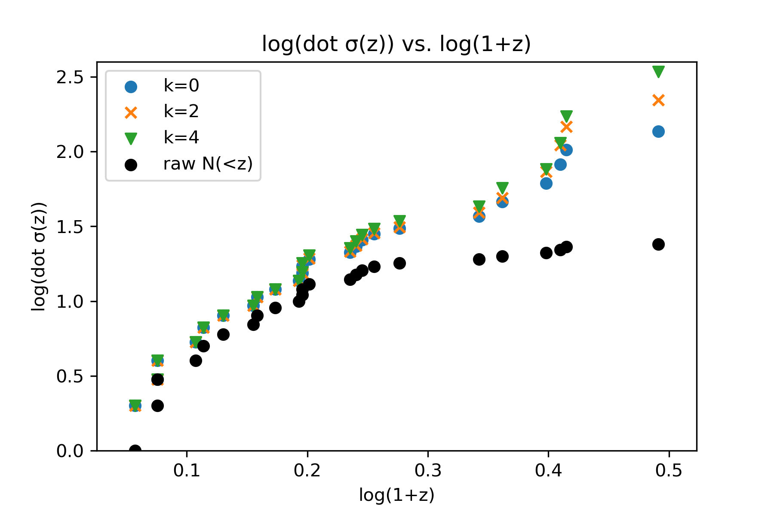
Dot sigma(z)

Slide 4
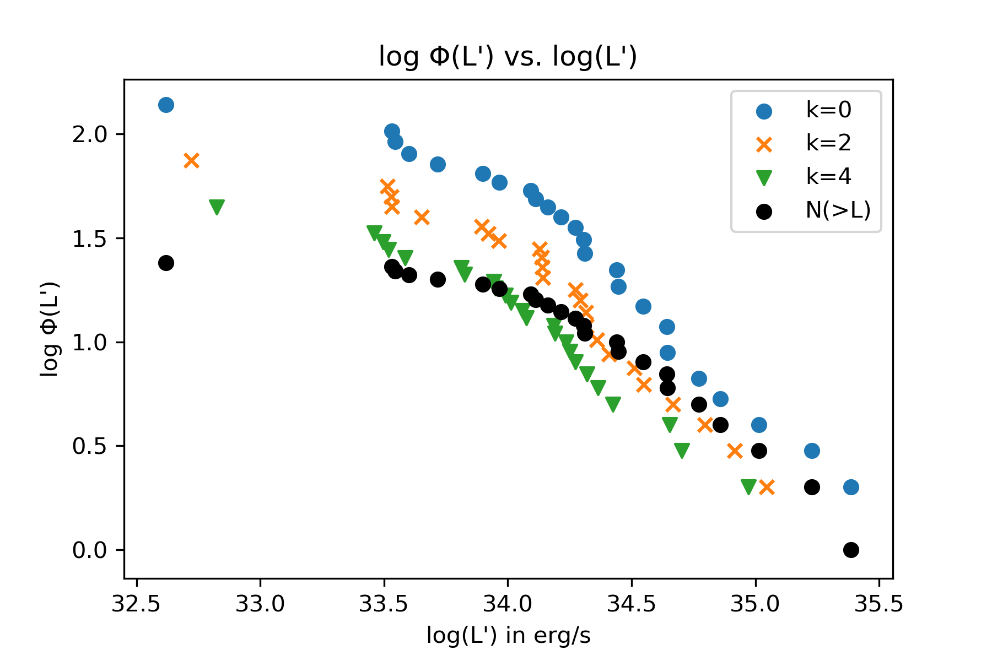
Cumulative LF

Slide 5
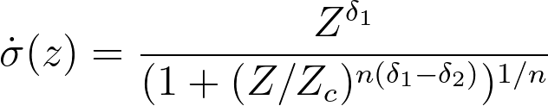
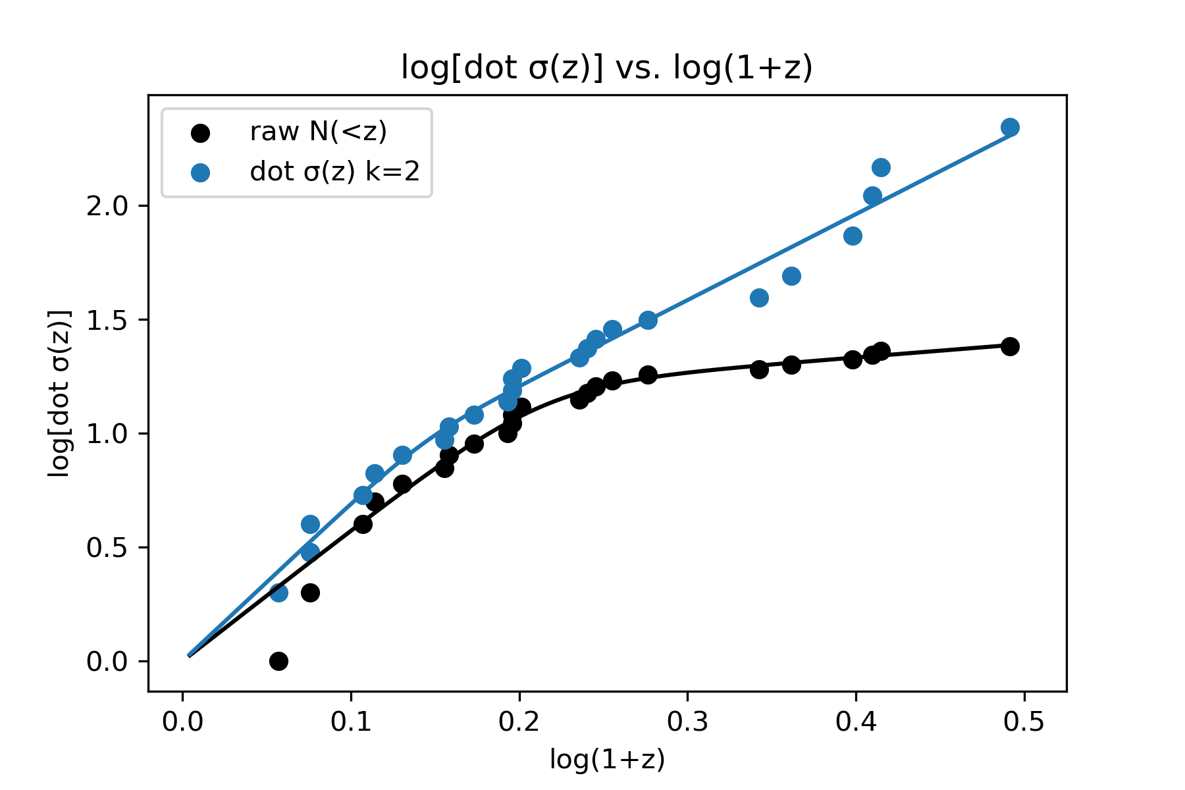

Dot sigma fit
For raw N(<z)
= [5.74, 0.589, 1.63, 2.82]
For dot sigma(z) (k=2)
= [6.92 3.77, 1.39, 8.23]

Slide 6
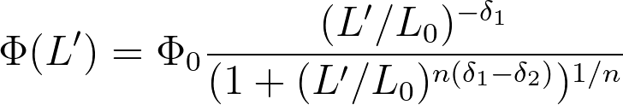
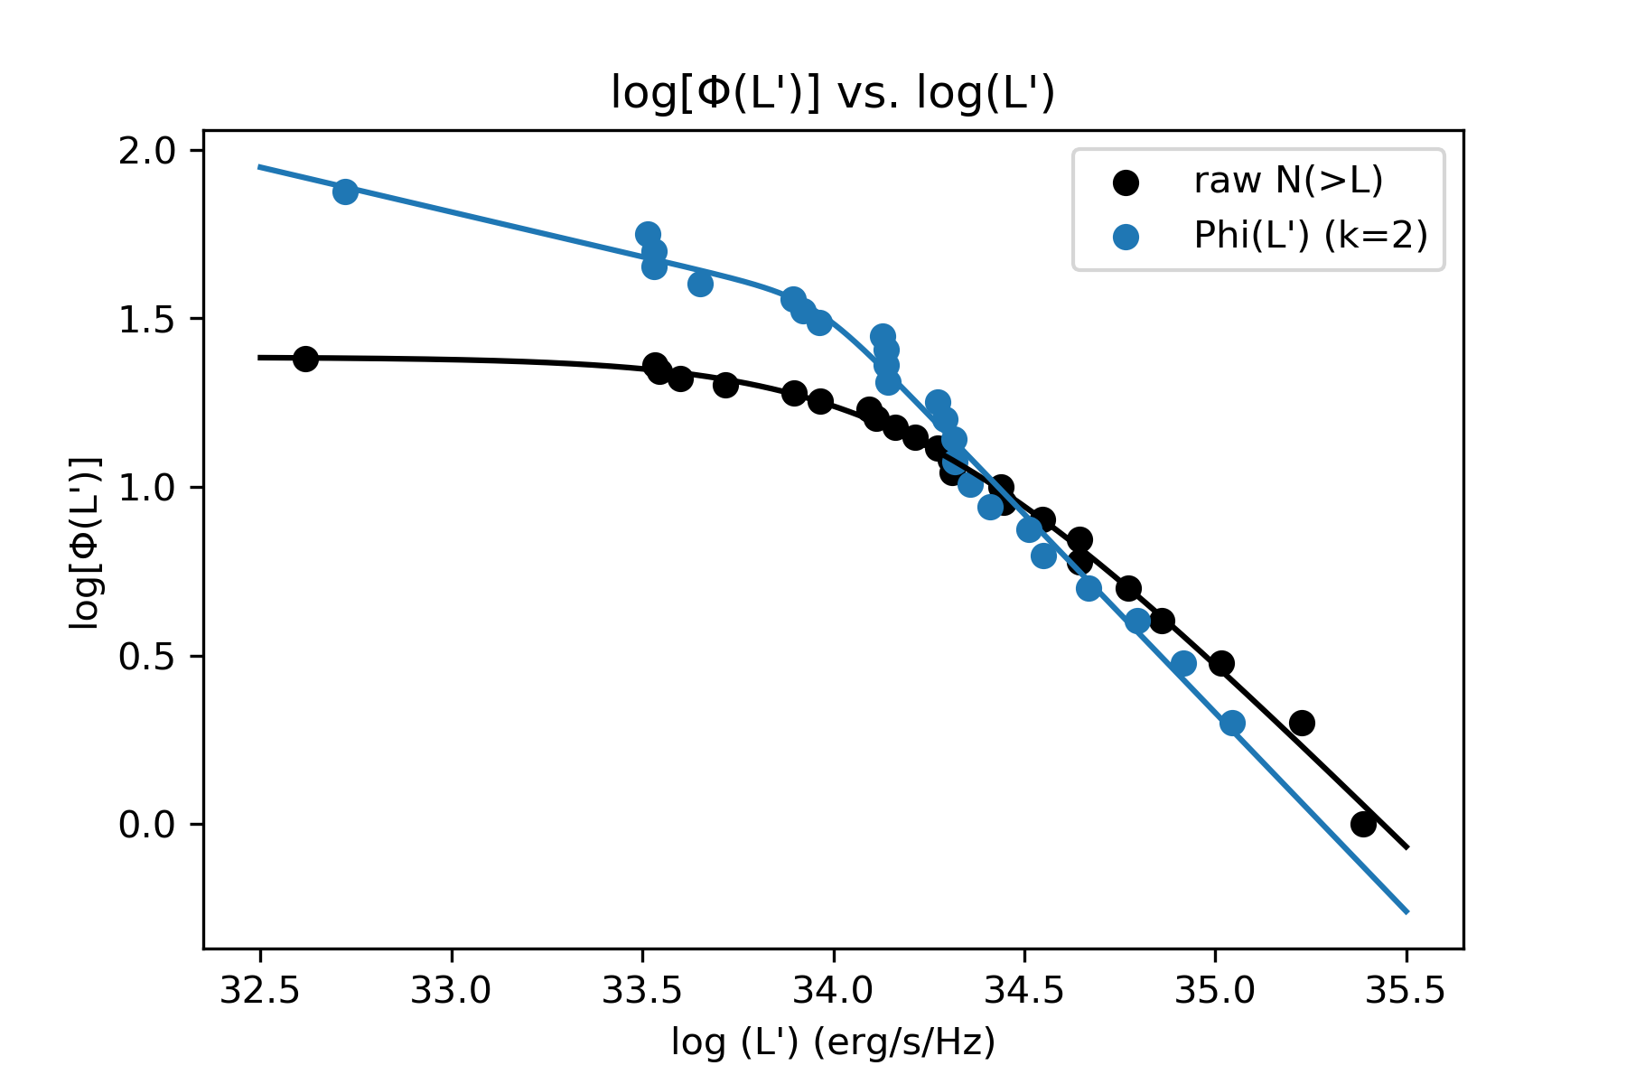
Cumulative LF fit
For raw N(>L):
= [1.38, 34.2, 0.00, 1.12, 1.24]
For Phi(L’) (k=2):
= [8.35, 33.95, 0.265, 1.18, 7.29]

